Slide 1
LAB #3
NICOLA BEZZO, MASOUD BASHIRI
Fall 2016
Autonomous Mobile Robots

Slide 2
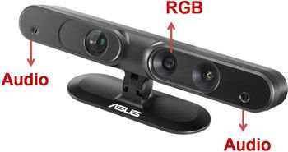

Asus Xtion PRO LIVE RGB, Depth and Microphones
Depth Image Size
(640x480) : 30 fps
Field of View
Horizontal: ${58}^{o}$
Vertical: ${45}^{o}$
Diagonal: ${70}^{o}$

Slide 3
Depth Sensing
IR Transmitter
Depth Camera
Structured Light (Active Depth Sensing)
Project a speckle pattern of infra red laser light (Transmitter)
Capture and Analyze the results (Depth Camera)
Depth from Blur and Stereo Vision (Passive Sensing)
Blur: Things further away – Astigmatic Lens
Stereo Vision: Thing viewed from two vantage points,
Look different based on distance

Slide 4
Launch 3dSensor
ssh into your turtlebot
roslaunch turtlebot_bringup minimal.launch
roslaunch turtlebot_bringup 3dsensor.launch
rostopic list
You should see a number of new topics being published
rostopic echo /scan

Slide 5
Visualize Kinect data in Rviz
On your Lenovo Laptop, open a terminal
Rosrun rviz rviz
Global Options->Fixed Frame = base_footprint
Grid->Reference Frame = odom
Click on the ‘Add’ button, from the ‘By Display Type’ tab select DepthCloud, RobotModel and LaserScan
Color Image Topic
Select camera/rgb/image_raw
Depth Map Topic
Select camera/depth_registered/image_raw

Slide 6
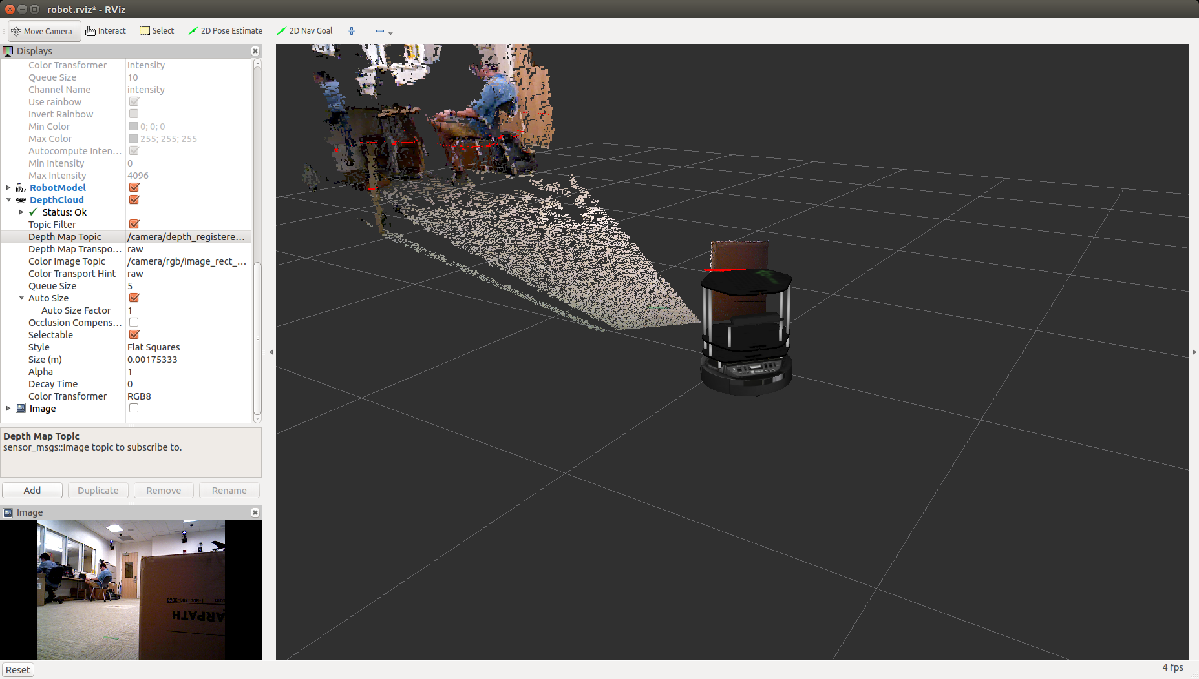

Slide 7
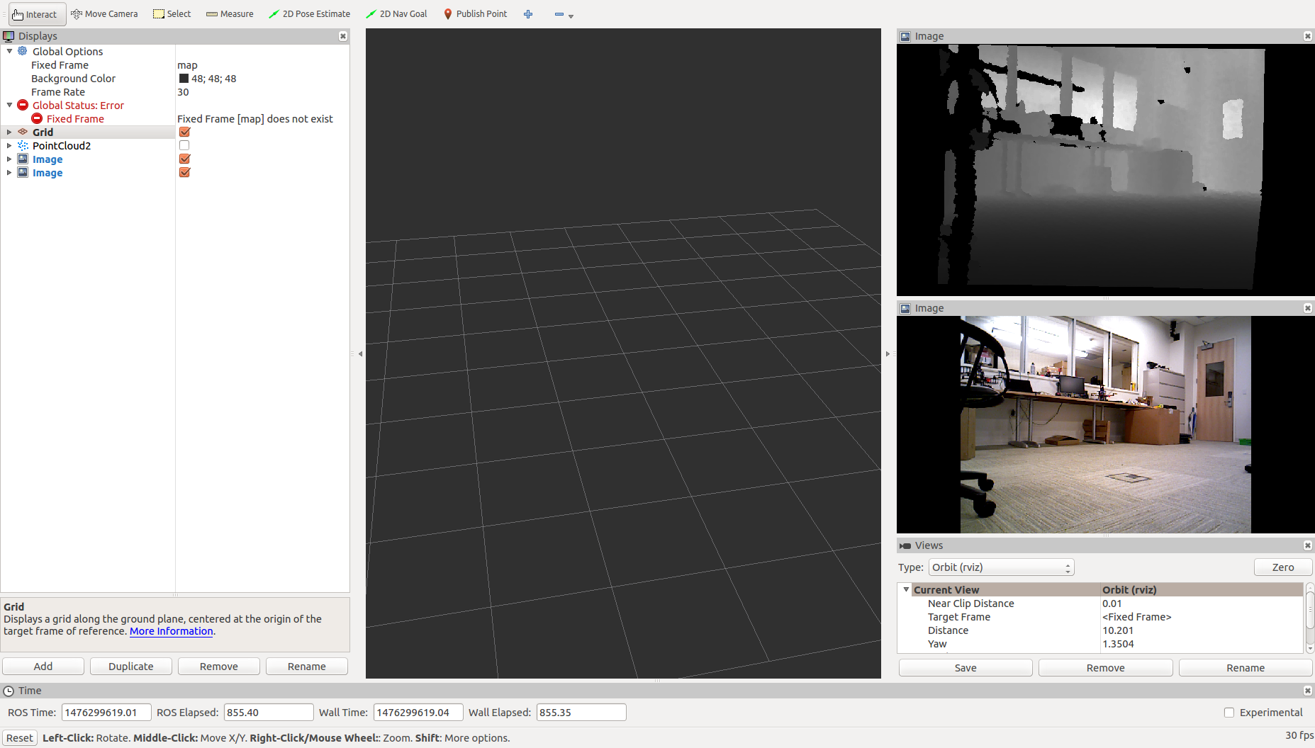
Visualize Kinect data in Rviz

Slide 8
How to subscribe to the virtual(fake) laser data
Data Type:
#include <sensor_msgs/LaserScan.h>
In python: from sensor_msgs.msg import LaserScan
Subscribe:
/scan topic
Read ranges[0-639]
Values range from 0.44 to 10 (meters), some will be NaN (not a number)

Slide 9
AMR Lab #3 – Due Thu 10/27/2016 during Lab hours
Use the Asus Xtion Pro (kinect) sensor for the following behaviors:
Use the cruise controller developed in the first lab assignments, set a speed and make the robot stop at 1m from any obstacle in front of the turtlebot.
run an obstacle avoidance behavior. Use the turtlebot box as the obstacle to avoid. Implement a go-to-goal behavior making the robot move 4m ahead while avoiding the obstacle.
Implement a follow-me behavior. Make the turtlebot follow you around the lab
extra: use the camera on the xtion sensor to recognize and follow a specific object (e.g., a red ball, your face, your backpack, a drawing on a piece of paper, etc.)

